Slide 1
NoSQL IN BANKING
Presented by:-
ANUSHA
SANMATI
RUCHIKA
RITHIKA
SREELAKSHMI

Slide 2
Table Of Contents
Banks and databases
Why SQL for critical data
WHY NoSQL
Document Store
About MongoDB
Example-Barclays

Slide 3
BANKS AND DATABASES
1. Choosing the right database is extremely important for any institution to support their growing data requirements and and maximise their profits with minimal investment, meanwhile providing the desired characteristics.
2. All banks use all kinds of databases. There's not a single bank that uses only one kind of database. It depends on the appropriateness for the particular task.
3. Banks need to handle lot of other things than just retail banking. It needs to look into fraud detection, analytics, market research, trade analysis, equity and forex.

Slide 4
WHY SQL FOR THE CRITICAL DATA
Technologically established and cannot afford risk.
The money data is comparatively simple and stored with a proper schema with the most important relations being Account, Transfer, Withdrawal and Deposits.
Performance is important, but not at the cost of reliability.
Eventual consistency nature of NoSQL
Banks usually tend to buy software rather than build themselves.
Lack of maturity, support and expertise in NOSQL.
In a digital economy, the end-customer experience is everything, banks are increasingly looking to create and integrate IoT, mobile and AI applications. These apps require a database to match. This is where non-relational (NoSQL) database technology enters the market.

Slide 5

NOSQL
NoSQL originally refers to "non SQL" or "non relational" database. NoSQL is a non-relational database that stores and accesses data using key-values. Instead of storing data in rows and columns like a traditional database .

Slide 6
WHY NOSQL?
Scalability
High availability
Flexibility
Performance

Slide 7
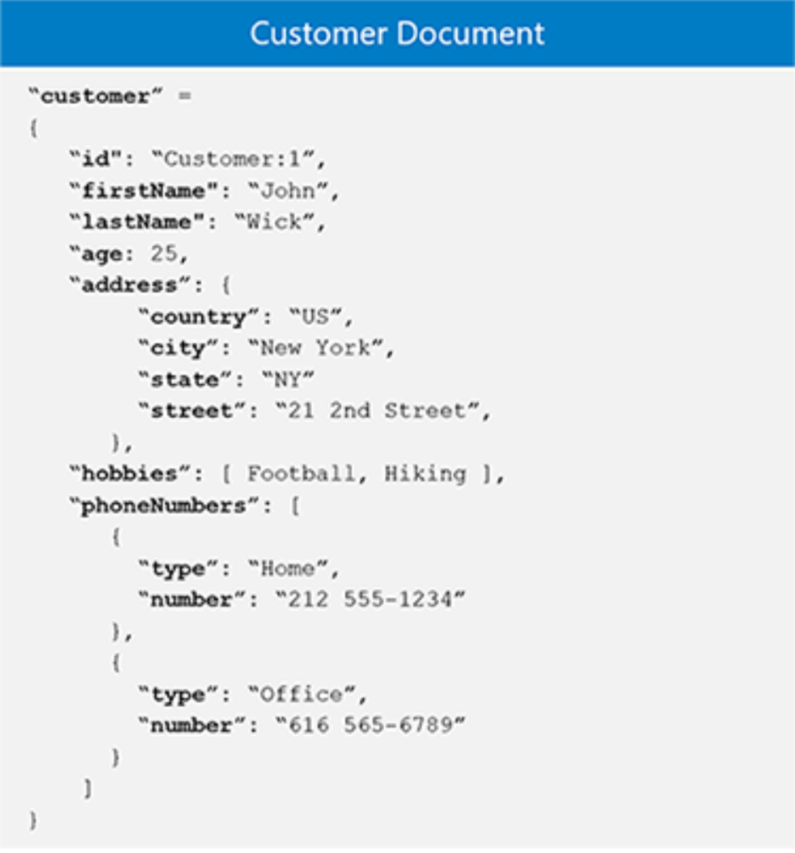
DOCUMENT STORE
A document-oriented database or a NoSQL document store is a modern way to store data in JSON(JavaScript Object Notation) format rather than simple rows and columns. It allows you to express data in its natural form,the way it's meant to be.In contrast to rows and columns used in traditional databases, NoSQL databases keep data in documents. These documents follow a minimum of standard format rule. The JSON format is the format of choice for NoSQL databases.A JSON document is simply more compact and more readable.JSON format has three basic foundations:
Key value pairs or attributes
Embedding JSON objects
Arrays

Slide 8
Mongo db working model
Database
Collections
Document

Slide 9
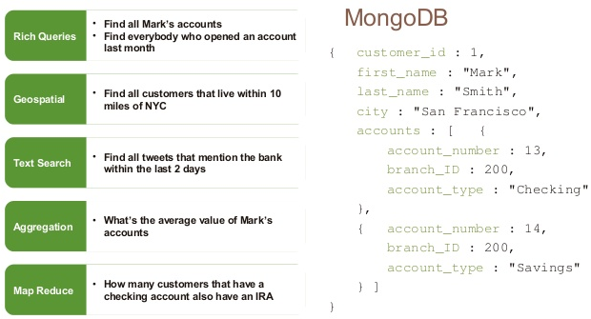
“NOSQL”, yet featured

Slide 10

360 view of customers
Mobile
Similar processes and systems duplicated
Changes done in multiple places
Siloed view of customer
Branch
Computer
Cards
loans
Computer
Central Functions
Call centre
Call centre
Deposit accounts
Mobile
Branch
ATM

Slide 11
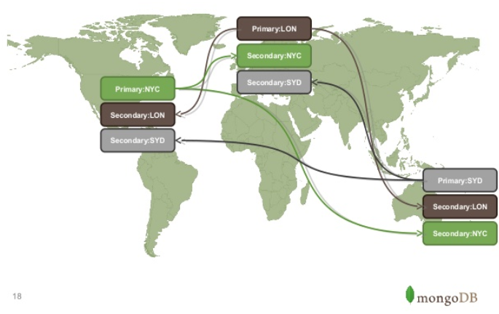
Global Synchronization

Slide 12
Barclay’s example
SIGNIFICANT CHALLENGE
MAINFRAME
IN 2015
INVESTIGATED
ODS
Meeting customer demand for new digital banking services
critical applications
single point of failure.
Bank experienced two service outages as a result of mainframe failures, which prevented customers from making payments
· How it could access customer data when mainframes systems became unavailable.
Resulted in the creation of an ODS based on MongoDB’s NoSQL database software, that sits between services such as its online/mobile banking and its mainframe systems
ODS :
Read only data
Transaction history
DATA CACHE-design principles
get the data outside of the mainframe as quickly as possible
created a layer of abstraction, so that the channel doesn’t know that it’s talking to the ODS or the mainframe
Got to be resilient and secure.

Slide 13
Thank you

